Slide 1

Install WSL 2 on Windows 10 for Insiders

Slide 2
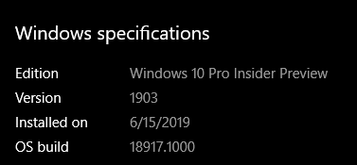
Prerequisites
Have Windows 10 build 18917.100 or later installed. You will have to be an insider for this.

Slide 3
Prerequisites
Install the VirtualMachinePlatform optional feature (Hyper-V)
Run this in Powershell: Enable-WindowsOptionalFeature -Online -FeatureName VirtualMachinePlatform
A reboot is required

Slide 4
Prerequisites
Install the WSL optional feature and then get a distribution
Youtube link: https://youtu.be/XDvt4dIN-Mw
GitHub link: https://github.com/itknowledge4/QuickTips/tree/master/Install%20Ubuntu%20on%20Windows%2010%20(WSL%20on%20Windows)

Slide 5
Install WSL 2
No need! It is already installed. Just convert an installed distribution to use version 2.
Get distro list: wsl -l –v
Convert distro: wsl --set-version Ubuntu-18.04 2
You can use v1 and v2 distros on the same machine.

Slide 6
Helpful links
MS Docs: https://docs.microsoft.com/en-us/windows/wsl/wsl2-index
MS Blog: https://devblogs.microsoft.com/commandline/wsl-2-is-now-available-in-windows-insiders/

Slide 7
https://www.youtube.com/channel/UCcZ-jLbPwNr8E_v9-65n8Iw https://github.com/itknowledge4

